Slide 1
Text Classification
Classification & Evaluation
Ayoub Bagheri

Slide 2
Outline
Text classification
Algorithms
Evaluation

Slide 3
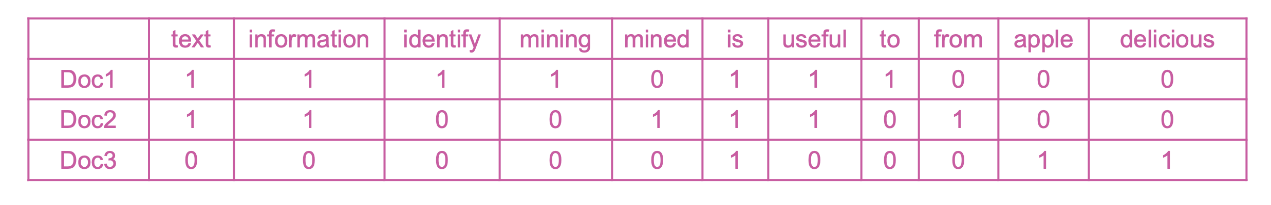
Bag-of-Words representation
Doc1: Text mining is to identify useful information.
Doc2: Useful information is mined from text.
Doc3: Apple is delicious.
Document-Term matrix (DTM):

Slide 4
Text classification
Supervised learning: Learning a function that maps an input to an output based on example input-output pairs.
infer a function from labeled training data
use the inferred function to label new instances
Human experts annotate a set of text data
Training set
Document | Class
Email1….. | Not spam
Email2…. | Not spam
Email3…. | Spam
… | …

Slide 5
Applications
Assigning subject categories, topics, or genres
Spam detection
Authorship identification
Age/gender identification
Language Identification
Sentiment analysis

Slide 6
Quiz?
Which one is not a text classification task? (less likely to be)
Author's gender detection from text
Finding about the smoking conditions of patients from clinical letters
Grouping similar news articles
Classifying reviews into positive and negative sentiment

Slide 7
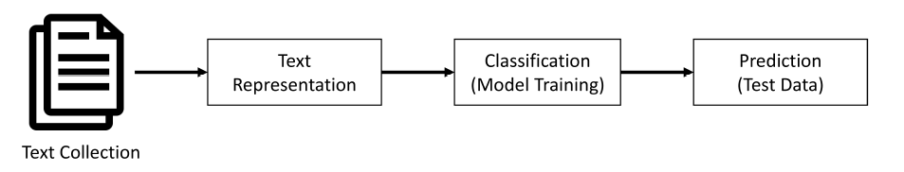
Simple pipeline

Slide 8
Preparing data
Text pre-processing
Data splitting
Training
Validation (development)
to tune the hyperparameters
Test
Text representation

Slide 9

K-fold cross validation
https://scikit-learn.org/stable/modules/cross_validation.html

Slide 10
How to classify this document?
Documents by vector space representation
?
Sports
Politics
Finance

Slide 11
Text Classification: definition
Input:
a document d
a fixed set of classes C = {c₁, c₂,…, c_{J}}
Output: a predicted class c ∈ C

Slide 12
Classification Algorithms

Slide 13
Hand-coded rules
Rules based on combinations of words or other features
Accuracy can be high: If rules carefully refined by expert
But building and maintaining these rules is expensive
Data/Domain specifics

Slide 14
Supervised Machine Learning
Input:
a document d
a fixed set of classes C = {c₁, c₂,…, c_{J}}
A training set of m hand-labeled documents (d₁,c₁),....,(d_{m},c_{m})
Output:
a learned classifier y:d → c

Slide 15
Outline
Naïve bayes
Logistic regression
Support-vector machines
K-nearest neighbors
Neural networks
Deep learning

Slide 16
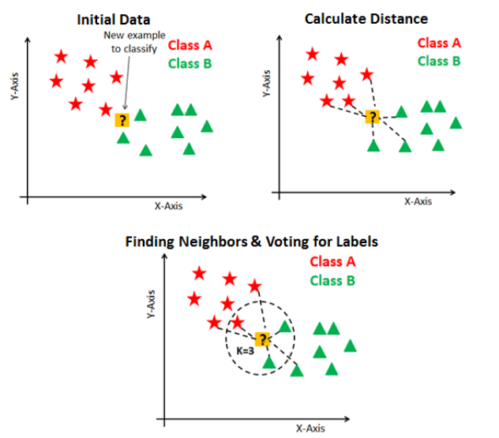
K-nearest neighbor

Slide 17
Naïve Bayes
great | 2
love | 2
recommend | 1
laugh | 1
happy | 1
... | ...
y(
)=c

Slide 18
Bayes’ rule
For a document d and a class c

Slide 19
Learning naïve Bayes
MAP is “maximum a posteriori” = most likely class
Bayes Rule
Dropping the denominator

Slide 20
Learning naïve Bayes
Document d represented as features x1..xn
Could only be estimated if a very, very large number of training examples was available.
We can just count the relative frequencies in a corpus

Slide 21
Learning naïve Bayes
Sec.13.3
Simply use the frequencies in the data

Slide 22
Neural networks, “deep learning”
Compositional approach to curve-fitting;
“Biologically inspired”
(but don’t take that too seriously);
Sound cool.

Slide 23
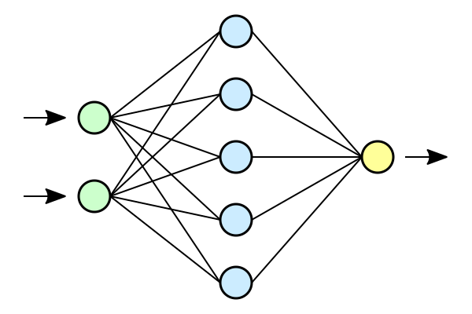
Neural network

Slide 24
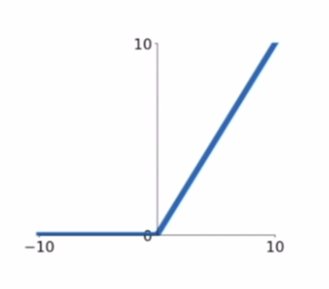
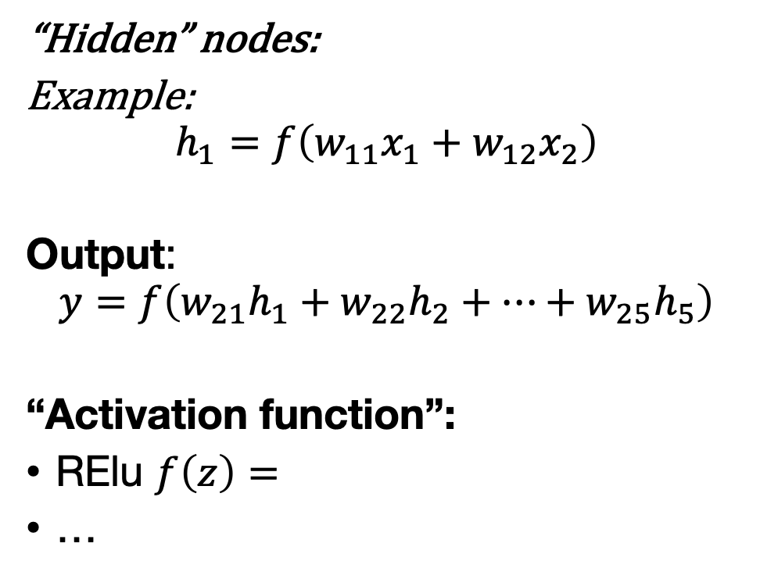
Neural network
“Hidden” nodes:
Example:
$$h_{1}=f\left(w_{11}x_{1}+w_{12}x_{2}\right)$$
Output:
$$y=f\left(w_{21}h_{1}+w_{22}h_{2}+…+w_{25}h_{5}\right)$$
“Activation function”:
RElu $f\left(z\right)=$
…

Slide 25
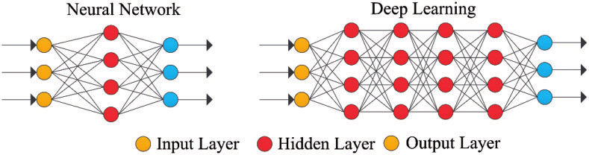
What makes a neural net “deep”?

Slide 26
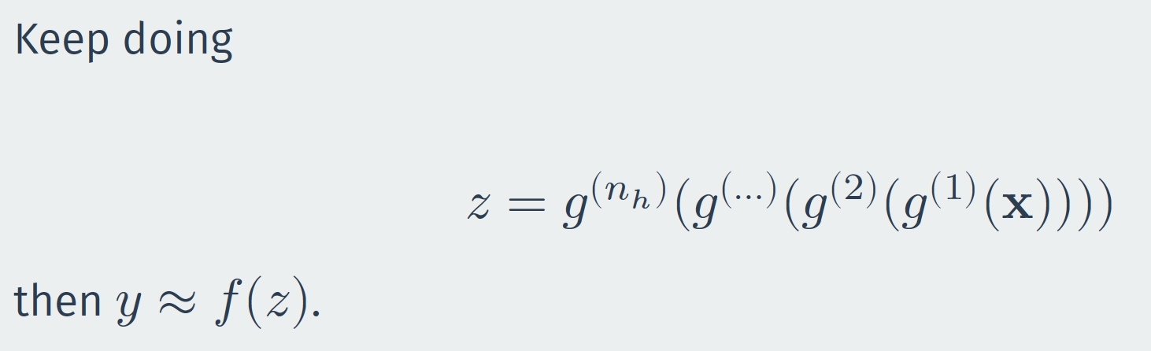
What makes a neural net “deep”?

Slide 27
Deep learning
Output of each hidden layer is input to subsequent one
Allow representation learning by building complex features out of simpler ones
Go deep: exponential advantages, less overfitting
Aggressive parameterization + aggressive regularization
Compositional: efficient parametrization
Learn relevant features: “End-to-end”

Slide 28

Different architectures
By adjusting the arrows, layers, and activation functions, you can create models that are tailored to specific data, e.g.
Convolutional (CNN): images, text, sound
Recurrent (RNN): time series, text
Graph (GNN): networks
…

Slide 29


Deep learning in practice
Good places to start:
https://keras.rstudio.com/
ISLR Chapter 10
Goodfellow et al.
Chollet (R/Python version)

Slide 30
Evaluation

Slide 31
No free lunch
“Any two optimization algorithms are equivalent when their performance is averaged across all possible problems”
(Wolpert & MacReady)

Slide 32
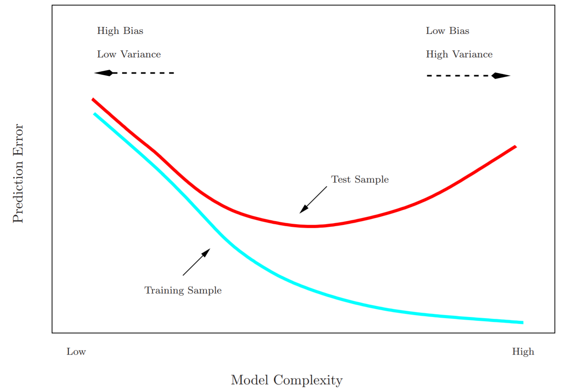

Slide 33
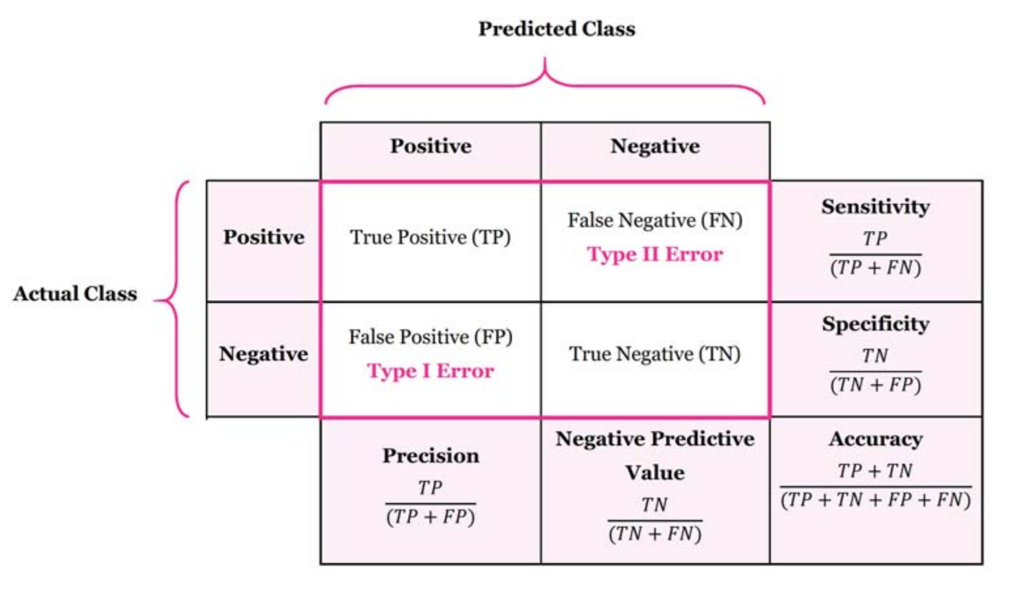
Confusion matrix

Slide 34
Accuracy
Accuracy is a valid choice of evaluation for classification problems which are well balanced and not skewed.

Slide 35
Precision and recall
Precision: % of selected items that are correct Recall: % of correct items that are selected
Precision is a valid choice of evaluation metric when we want to be very sure of our prediction.
Recall is a valid choice of evaluation metric when we want to capture as many positives as possible.

Slide 36

Source: https://en.wikipedia.org/wiki/F-score

Slide 37
A combined measure: F
A combined measure that assesses the P/R tradeoff is F measure (weighted harmonic mean):
The harmonic mean is a very conservative average
People usually use balanced F1 measure
i.e., with β = 1 (that is, α = ½): F = 2PR/(P+R)

Slide 38
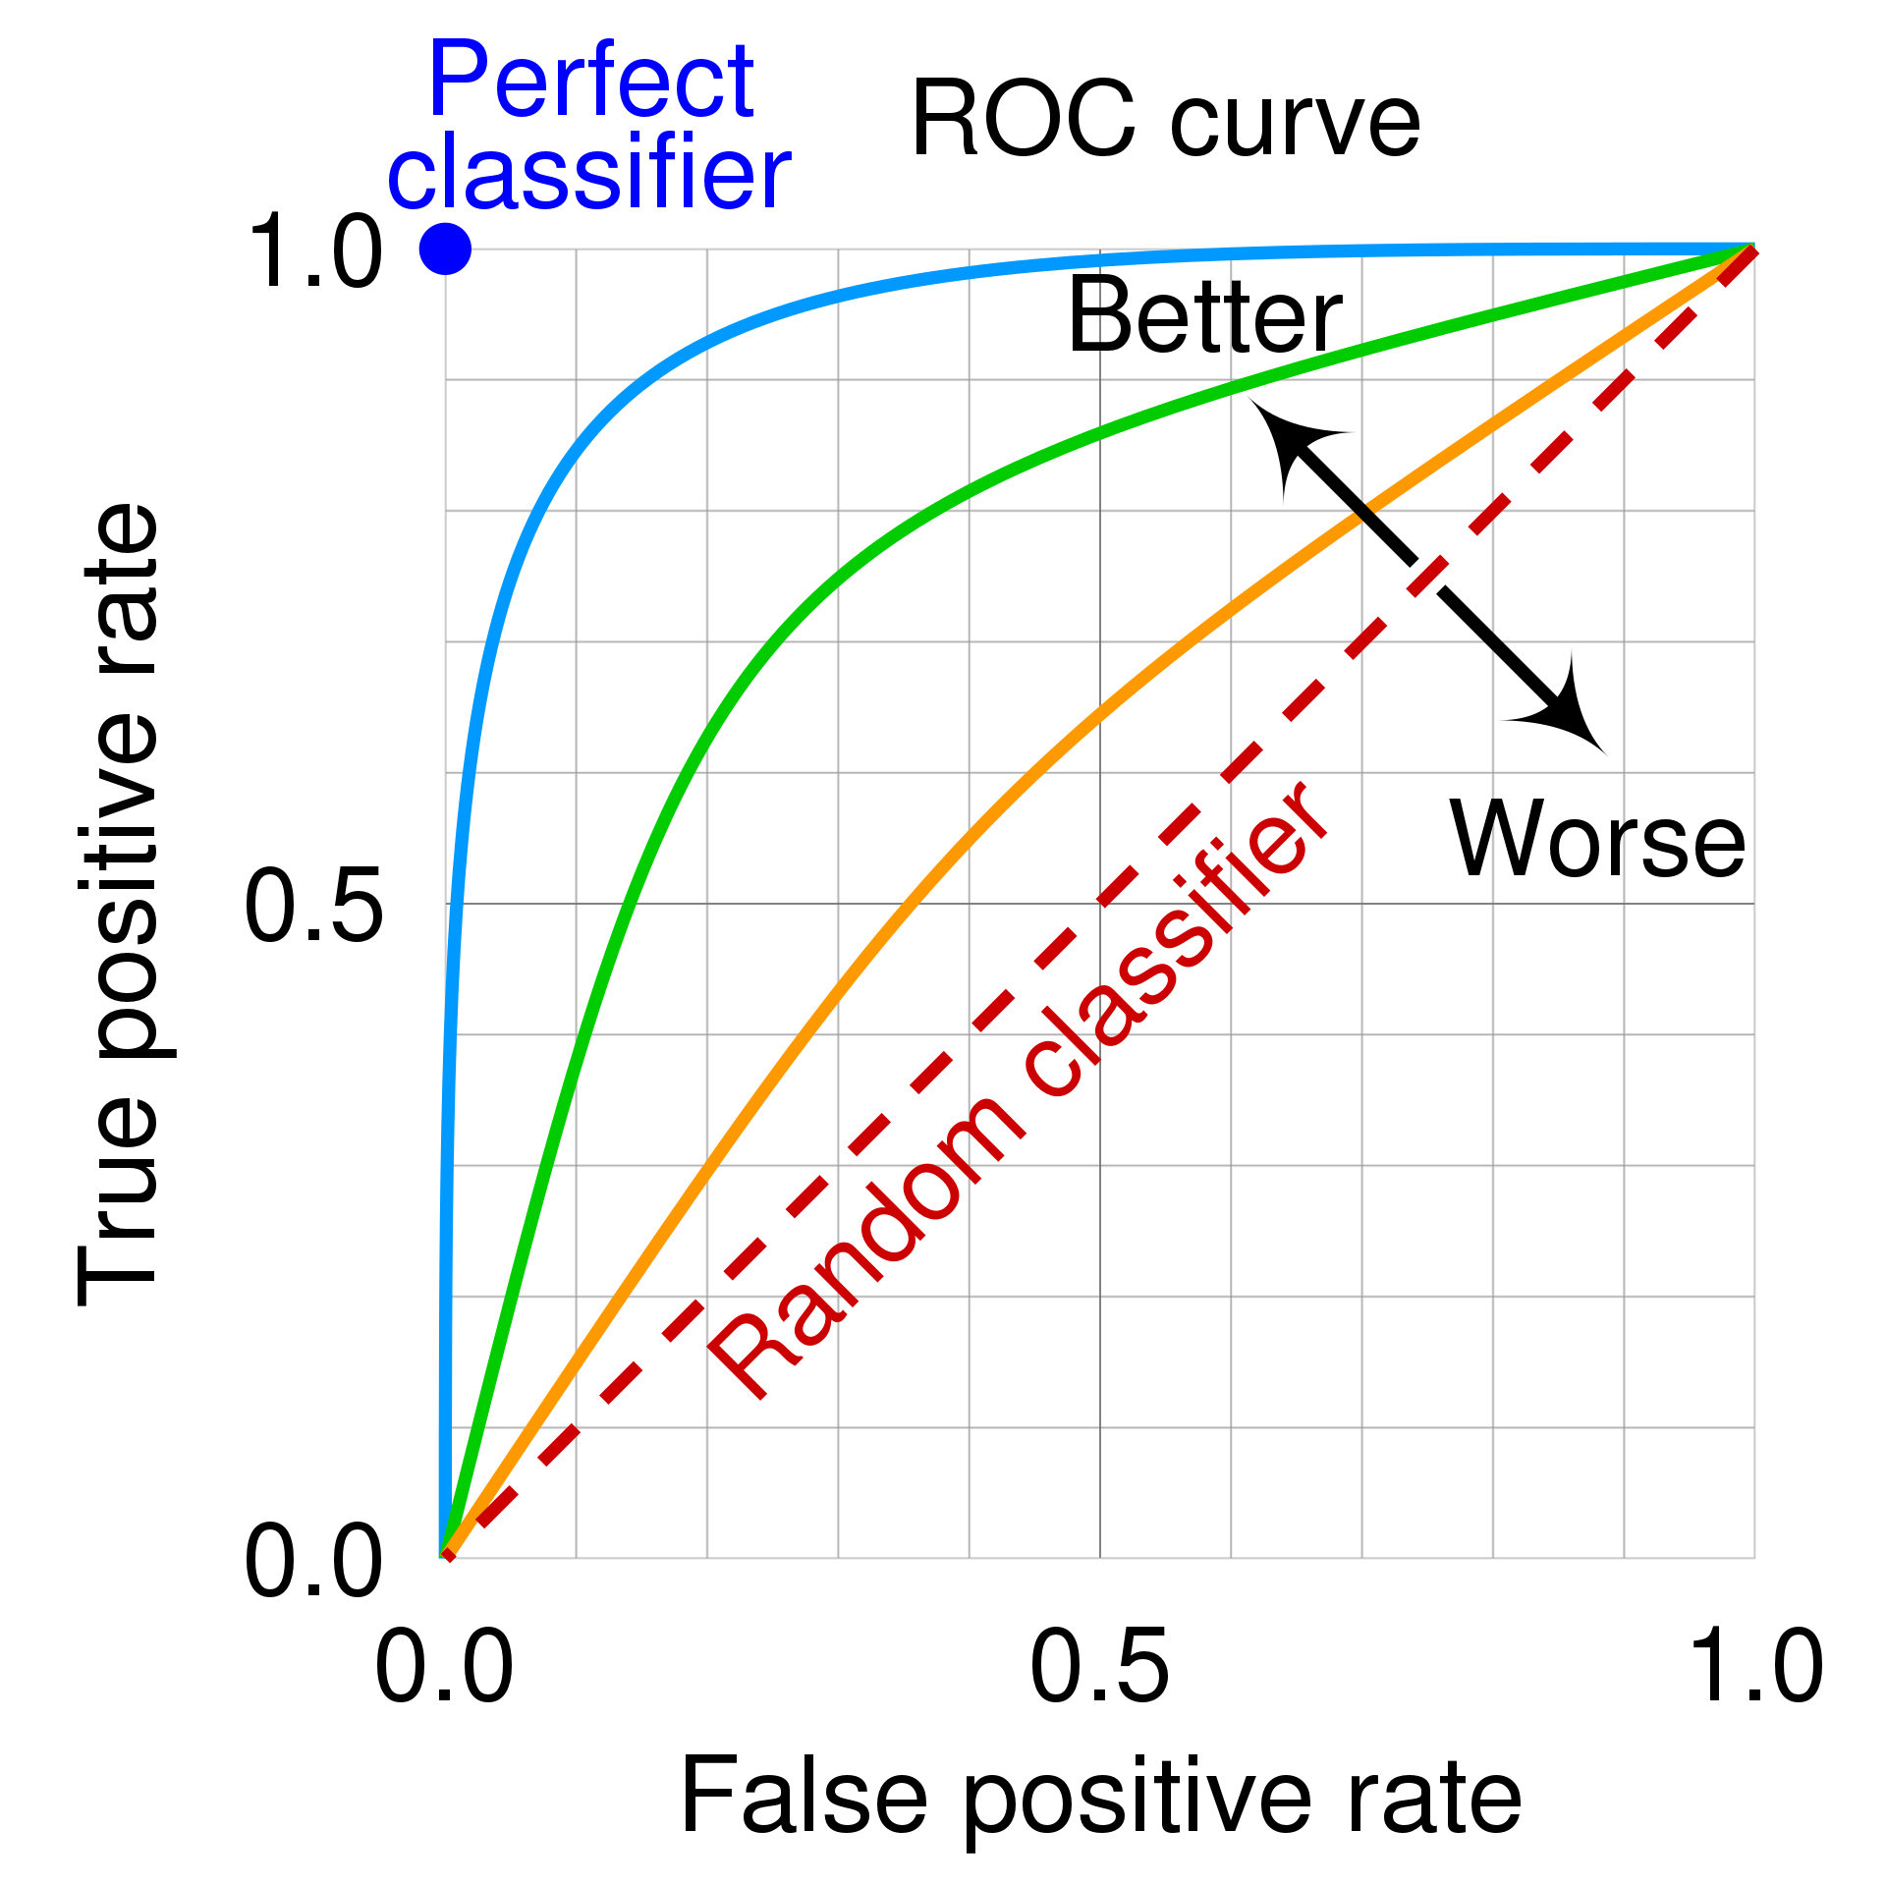

Slide 39
Practical
Multiclass text classification of 20newsgroups articles.

Slide 40
Questions?

